Slide 1
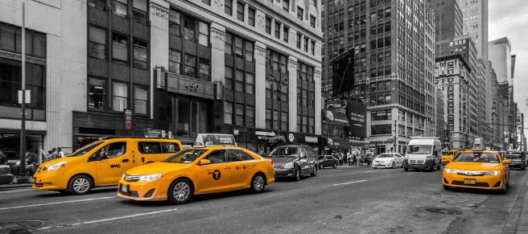

FRAUD DETECTION IN NYC TAXI SERVICES: A DATA SCIENCE APPROACH USING TLC TRIP DATA (JANUARY 2023)
MUHAMMAD KHISANUL FAKHRUDIN AKBAR

Slide 2



INTRODUCTION
The New York City Taxi and Limousine Commission (NYC TLC) is a government agency established in 1971 to regulate commercial transportation services such as taxis, limousines, and ride-hailing apps in NYC. To support oversight, the TLC collaborates with certified technology vendors to record each taxi trip in a structured system known as the TLC Trip Record.
In this industry, fraud can lead to significant financial losses. Therefore, analyzing taxi trip data is essential to identify potentially invalid or unusual trips as part of efforts to detect fraudulent activities.
1

Slide 3

PROBLEM STATMENT
This dataset contains various important information, such as pickup time and location, as well as other supplementary details for each trip. Based on the NYC taxi trip data, there is an indication that some transactions and trips may be invalid or deviate from normal patterns. Therefore, in-depth analysis is required to detect possible fraud in the system. The main problems to be addressed are :
Detecting Travel Abnormality
Distance abnormalities: Are there trips with unreasonable distances?
Duration abnormalities: Are there trips that last too long for short distances or are too fast for long distances?
Fare abnormalities: Are there trips where the fare category is inconsistent?
Anomalies in pickup and drop off patterns
Identifying areas where trips frequently show anomalies.
Identifying specific times when trips frequently show anomalies.
Once abnormalities in trips, areas, and times with high anomaly frequencies are identified, we, as data analysts at NYC TLC, can provide recommendations or solutions to prevent such issues in the future and avoid losses for all parties involved.
2

Slide 4
Executive Summary
The NYC Taxi and Limousine Commission (NYC TLC) maintains trip records to ensure compliance and passenger safety. However, there are indications of fraud, such as manipulated trip distances, durations, and fare pricing, which could result in financial losses for service providers and passengers. Additionally, certain zones and time periods exhibit suspicious travel patterns. To prevent such losses and uphold system integrity, a comprehensive analysis is required to detect and mitigate potential fraudulent activities.
Taxi Demand:
Manhattan recorded the highest taxi activity with 37,352 trips, driven by its role as the city’s business, tourism, and entertainment hub.
Bronx and Staten Island showed very low trip volumes, suggesting limited taxi usage or service accessibility in those boroughs.
High-Anomaly Zones:
Bronx and Staten Island had the highest proportion of suspicious trips (36.27% and 33.33%), despite low total trips, indicating potentially serious anomalies.
Areas like Long Island City/Hunters Point and Queensbridge/Ravenswood in Queens had extremely high anomaly rates (>50%), highlighting the need for focused investigation.
Time-Based Anomaly Trends:
Suspicious trips peaked on weekdays, especially on Tuesday, Wednesday, and Monday, indicating that fraud is more prevalent at the start of the week. Weekends (Saturday and Sunday) had lower anomaly counts, though not entirely free of risk.
The highest anomaly frequency occurred during midday hours (11:00–15:00), followed by spikes during morning rush (06:00–09:00) and a gradual decline in the late afternoon (16:00–18:00). These timeframes align with high traffic and operational pressure.
3

Slide 5
AGENDA
1
2
3
Data Understanding
Taxi Demand
Indication of Fraud
4
5
6
Conclusion & Recommendation
Top Anomaly Location
Anomaly Travel Pattern
4

Slide 6

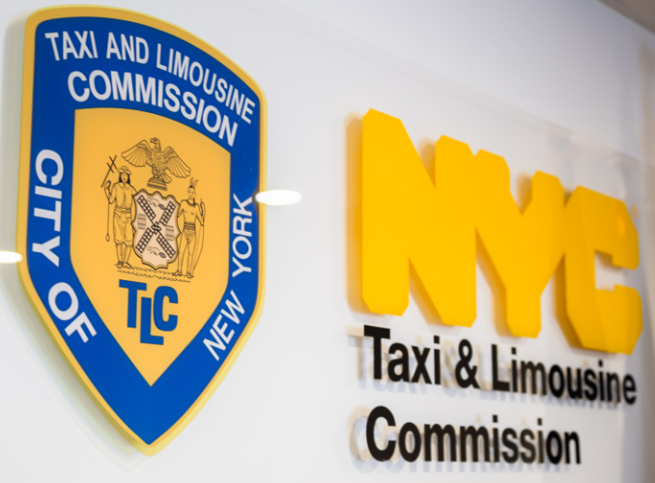
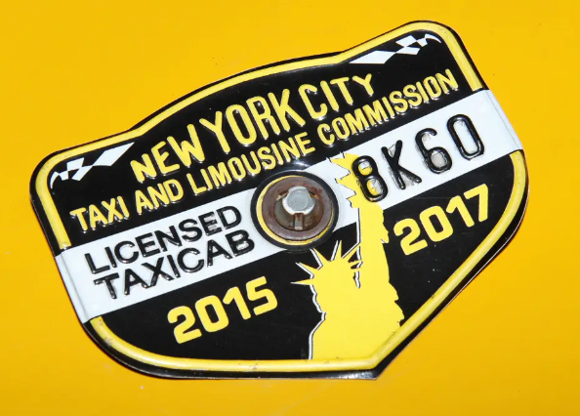
WHAT IS NEW YORK CITY TAXI AND LIMOUSINE COMMISSION (NYC TLC) ?
The New York City Taxi and Limousine Commission (NYC TLC) is a government agency that regulates commercial transportation services such as taxis, limousines, and for-hire vehicles in New York City. Its main duties include
licensing and inspecting vehicles and drivers.
setting fares for taxi and for-hire vehicle services.
protecting consumers from fraud or overcharging,.
promoting accessibility for all individuals.
5

Slide 7
WHERE IS THE DATA SOURCE?
This dataset contains taxi trip data in New York City collected by licensed vendors and periodically submitted to the Taxi and Limousine Commission (TLC). Although published by the TLC, they do not collect the data directly and cannot guarantee its accuracy, as it relies on third-party reports.
5

Slide 8
MANHATTAN LEADS WITH THE HIGHEST DEMAND, DOMINATES WITH 59% OF THE TOTAL TRIPS.
From the bar chart above, it can be seen that the borough with the highest taxi demand in January 2023 is Manhattan, with a total of 37,352 trips, accounting for 59% of the total trips in the dataset (63,182).
6

Slide 9
NYC HAS A TOTAL OF 220 ZONES. EAST HARLEM NORTH IS THE MOST IN-DEMAND ZONE, WITH 20.45% OF TOTAL TRIPS
20.45%
NYC has a total of 217 Zones, Zone is an administrative area that is below the level of a borough. East Harlem North is the most in-demand zone, having 12,921 trips and a share of 20.45% of 100% taxi demand in New York City. From this we can also conclude that the zones with the highest demand are mostly in Manhattan and there is one zone in position 3 which is in Queens, namely Forest Hills.
13.97%
6%
5.89%
5.68%
7

Slide 10
SUSPICIOUS TRIP PREVIEW
With a total of 60,160 trips spread across 220 zones in NYC, 5% of them or 3,022 trips were indicated as suspicious travels. This result was obtained by taking into account three factors namely Distance abnormalities, Time Travel abnormalities, and Fare abnormalities.
8

Slide 11
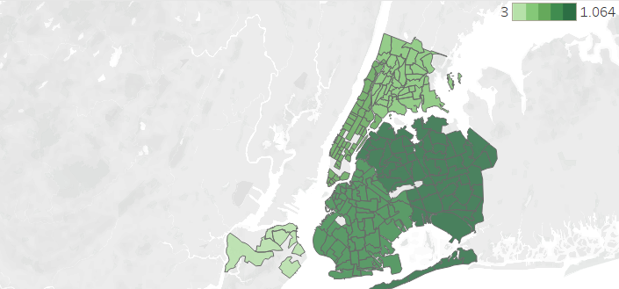
There were 2722 trips that recorded a distance of 0 miles or about 4.31% of the total trips, even though there were trip durations. This could indicate a Unusual Trip Distance.
UNUSUAL TRIP DISTANCE BY BOROUGH
9

Slide 12
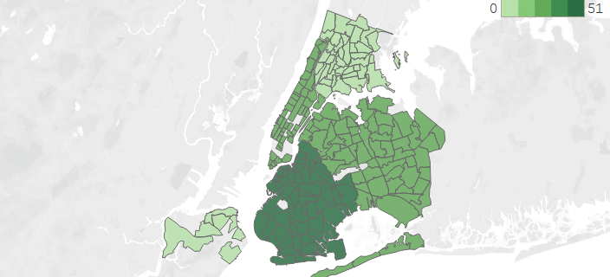
There were 111 trips or about 0.17% of the total trips, indicating Unusual Time Travel.
With indications of Travel too fast (<10 seconds for 5+ miles) or Travel too slow ( 1+ hour for <0.5 miles).
UNUSUAL TIME TRAVEL BY BOROUGH
10

Slide 13
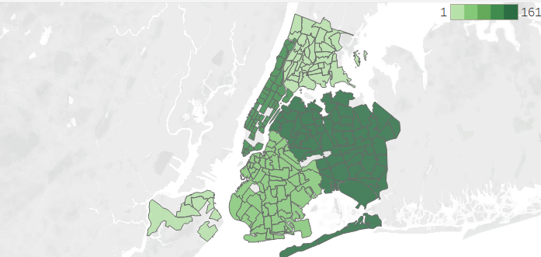
There were 317 trips or about 0.5% of the total trips, indicating Unusual Rate Code Fee.
With indications of trips that do not match the fare, in pick-up and drop-off locations.
Rate Code | Description
1 – Standard Rate | Standard rates within NYC city limits (5 boroughs)
2 – JFK | Fixed fare to/from JFK Airport and Manhattan.
3 – Newark | Travel from/to Newark Airport (EWR).
4 – Nassau/Westchester | Travel out of NYC to Nassau or Westchester counties.
5 – Negotiated Fare | Pre-agreed rates, usually for specific trips or specialized services.
6 – Group Ride | Special fares for group rides on certain routes.
UNUSUAL RATE CODE FEE BY BOROUGH
11

Slide 14
With 1,218 cases, Queens has become the center of suspicious travel.
Queens became the borough with the highest number of cases, far surpassing the others. A possible reason for this is its proximity to JFK Airport and LaGuardia Airport, which may increase the risk of fraudulent activities or unclear travel patterns. Additionally, Queens has extensive industrial, commercial, and residential areas, resulting in more diverse travel activities.
3,022 Total Cases
5% From Total Trips
12

Slide 15
Bronx and Staten Island have the highest proportions of suspicious trips
Queens has the highest number of suspicious trip cases in absolute terms, but the lowest proportion due to its large trip volume. In contrast, the Bronx and Staten Island show higher anomaly proportions despite having fewer cases, indicating a greater level of irregularity in areas with lower trip volumes.
3,022 Total Cases
5% From Total Trips
12

Slide 16
With 1,317 cases accounting for 39% of the total cases, Queens has become the center of suspicious travel.
The Bronx recorded 341 suspicious trips, placing it in the middle compared to other boroughs. This lower activity is likely due to the Bronx's focus on residential areas and a lower level of commercial activity compared to Manhattan or Brooklyn.
The Unknown zone recorded 147 cases, a significant number. In the NYC TLC Taxi Zone database, LocationID = 264 is listed as an unknown area, even though they are actually valid locations.
Meanwhile, Staten Island and EWR (Newark Airport) had very low case numbers, with only 4 and 1 cases, respectively. This can be explained by the lower taxi activity in Staten Island compared to other boroughs, as well as EWR’s location outside NYC, making TLC (Taxi & Limousine Commission)-related trips less frequent.
3,395 Total Cases
5% From Total Trips
13

Slide 17
East Harlem North (Manhattan) is the highest anomaly zone, with 234 suspicious trips, 7% from total cases.
East Harlem North (Manhattan) is the zone with the highest number of suspicious taxi trips. Contributing factors may include population density, business activity, or socioeconomic factors influencing unusual travel patterns.
Queens Dominates the list with six zones on top 10. Queens, as the borough with the highest number of suspicious trips, also stands out at the zone level, indicating irregular travel patterns in specific areas.
Manhattan Also Shows Many Anomalies. As a hub for business and tourism, Manhattan may have a higher potential for unusual travel activity or transportation fraud.
The Unknown zone requires further analysis, as hidden anomalies may exist due to incomplete data.
220 Total Zones
3,395 Total Cases
14

Slide 18
ANOMALY FREQUENCY PER DAY
Anomalies peak on Tuesday (575 anomalies), likely due to increased business, deliveries, and transportation activity. Monday (511) and Wednesday (520) also show high numbers, reflecting a busy start to the week. Anomalies gradually decline on Thursday (496) and Friday (443), possibly due to reduced work intensity and more predictable travel patterns. On weekends, anomalies are lower but still significant, with Saturday (421) and Sunday (428), likely driven by recreational, social, and tourism-related activities.
15

Slide 19
ANOMALY TREND BASED ON TIME
Anomalies peak between 11:00 - 15:00 due to high midday activity, then decline after 15:00 as travel stabilizes. Midnight to early morning (00:00 - 05:00) sees low anomalies, likely linked to nightlife transport and night shift workers, with a sharp drop at dawn (05:00 - 06:00) due to minimal traffic. Critical periods include morning rush (07:00 - 09:00) with increased work and school commutes, and afternoon/evening (16:00 - 18:00) with a gradual decline as people return home.
16

Slide 20
CONCLUSION & RECOMMENDATION
To reduce congestion and improve transportation efficiency, it is necessary to optimize taxi pickup and drop-off points, especially in business centers, tourist areas, like East Harlem North and East Harlem South Zones
Manhattan has the highest number of trips, totaling 37,474, far surpassing other boroughs such as Queens (17,261) and Brooklyn (8,014).
Enhanced monitoring of taxi trips in Queens is necessary, especially in areas with high anomaly volumes such as Astoria and Queensbridge. Measures that can be taken include installing surveillance cameras, and implementing a more transparent reporting system for drivers and passengers.
Queens has the highest number of suspicious trips, reaching 1,317 cases, despite having a lower total number of trips compared to Manhattan.
17

Slide 21
CONCLUSION & RECOMMENDATION
The East Harlem North area requires stricter supervision through collaboration between transportation authorities and law enforcement to prevent illegal activities. Measures such as increasing officer presence at strategic points can help reduce potential fraud or suspicious activities.
East Harlem North in Manhattan recorded the highest number of anomalies at the zone level, with 234 cases, or approximately 0.37% of all recorded trips.
To prevent fraudulent trip recordings and GPS data manipulation, regular taximeter updates and maintenance are needed for accurate trip logging. Additionally, enhancing GPS software with anomaly detection can help identify unrealistic locations and irregular travel patterns, ensuring reliable data recording.
The area categorized as Unknown recorded a relatively high number of anomalous trips, reaching 147 cases, which could indicate recording errors or trip location manipulation.
18

Slide 22
CONCLUSION & RECOMMENDATION
Since the highest number of anomalies occurs on weekdays, increased inspections and monitoring of taxi activities on these days are necessary. This could include random vehicle and driver checks, as well as real-time trip data monitoring to identify irregular patterns.
The frequency of suspicious trips tends to be higher on weekdays, especially on Tuesday with 575 cases, followed by Wednesday (520) and Monday (511).
The highest number of anomalous trips occurs from midday to the afternoon, with a significant spike between 2:00 PM - 3:00 PM and consistently high suspicious activity between 11:00 AM - 4:00 PM.
Given the high number of anomalous trips during this period, surveillance and digital monitoring should be intensified. Additionally, additional regulations on trips occurring during these hours could be implemented to prevent the misuse of transportation services.
19

Slide 23
THANK YOU
Out of 63,877 trips in NYC, 5% were classified as suspicious. Among the various recommendations outlined, the top priority is improving, maintaining, and validating the data recording system at NYC TLC, as it is the most critical factor.

